Slide 1
Telecom Sales Case Study
Impact of display advertising campaign on online sales

Slide 2
Problem Statement
The goal is to identify the impact of the display campaign advertisementto seek opportunities for increasing revenue, improving customer targeting, and enhancing overall business strategies.
In order to optimize sales performance and better understand customer behavior, conduct a comprehensive analysis of the brand's sales data as a result of the campaign.

Slide 3
Definitions
Sales = Total Number Of Products
Orders = Count of Transactions

Slide 4
Overview
Sales = Total Number Of Products
Orders = Count of Transactions

Slide 5
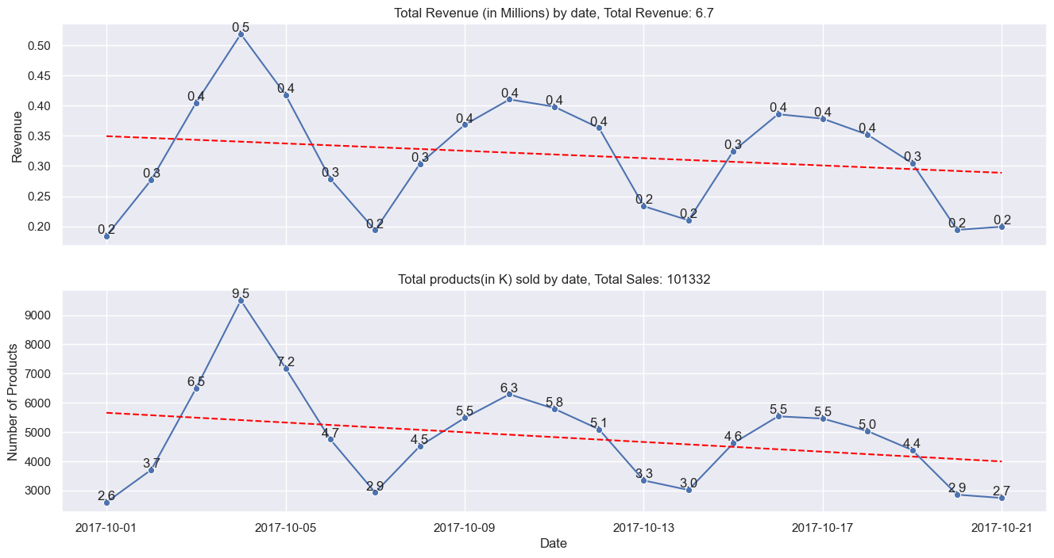
Overall Sales and Revenue
Total Revenue: 6.7M
Total Sales:101.3k
The peaks occurred on 2017/10/4, with Revenue reaching $0.5M.
Peaks in Revenue and Sales occur approximately every 6 days.
Both Revenue and Sales show a downward trend.
Revenue and sales follow the same trend.

Slide 6
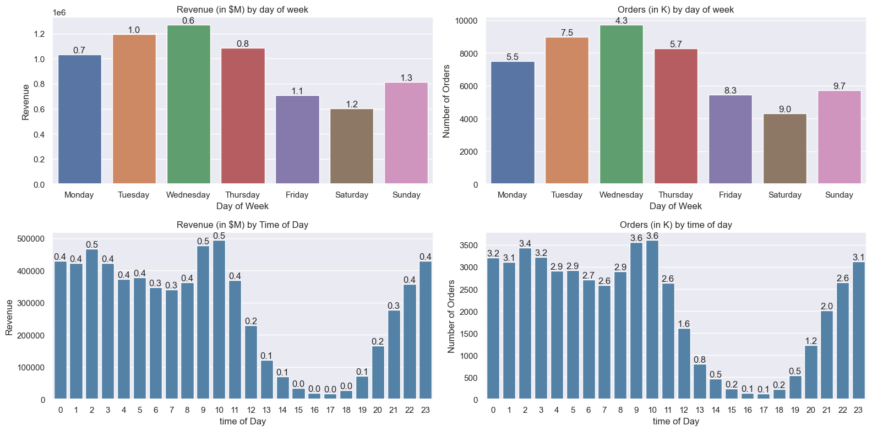
Orders and Revenue by Time Dimensions
Day of Week:
Wednesday has the highest Revenue and Sales.
Saturday has the lowest Revenue and Sales.
Time of Day:
Revenue and Sales peak at 9-10am
Revenue and Sales lowest at 4-5pm
Focus:
Mon, Tues,Wed, 9-10am sales

Slide 7
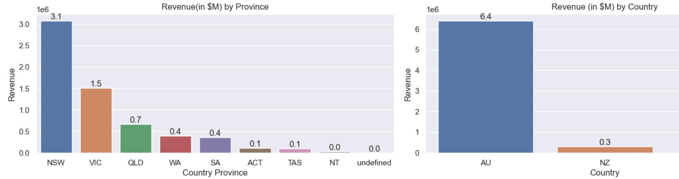
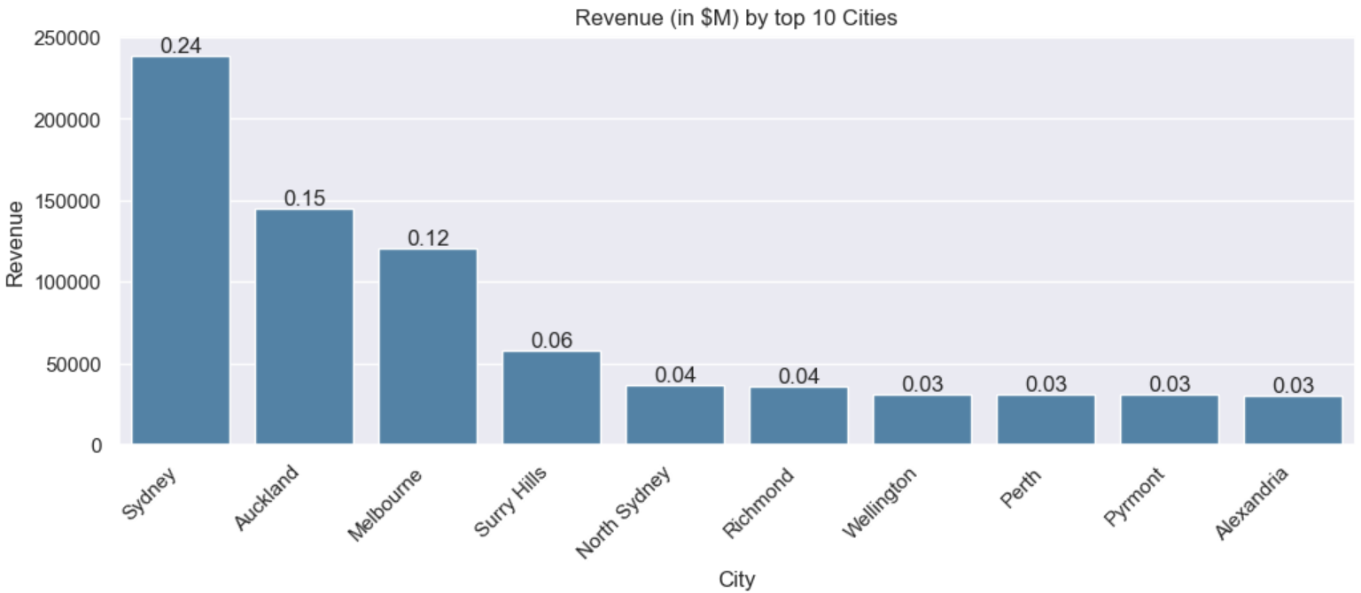
Revenue by Geography
Cities are chosen based on top 10 revenue.
Top 3 Revenue - Province:
NSW - 49%
VIC - 23%
QLD - 11%
Top Revenue - Country
AU - 95%
Top 3 Revenue - City
Sydney - 3.5%
Auckland - 2.2%
Melbourne- 1.79%

Slide 8
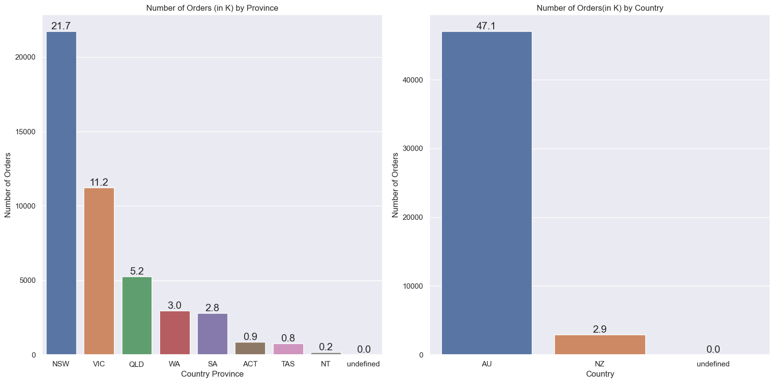
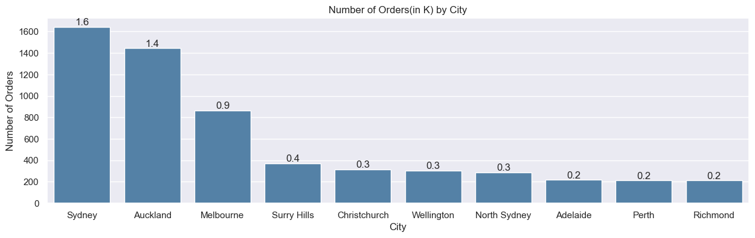
Orders by Geography
Cities are chosen based on top 10 revenue
Top 3 Sales - Province:
NSW - 47%
VIC - 24%
QLD - 11%
Top Sales- Country
AU - 94%
Top 3 Sales - City
Sydney - 3.2%
Auckland - 2.8%
Melbourne - 1.8%

Slide 9
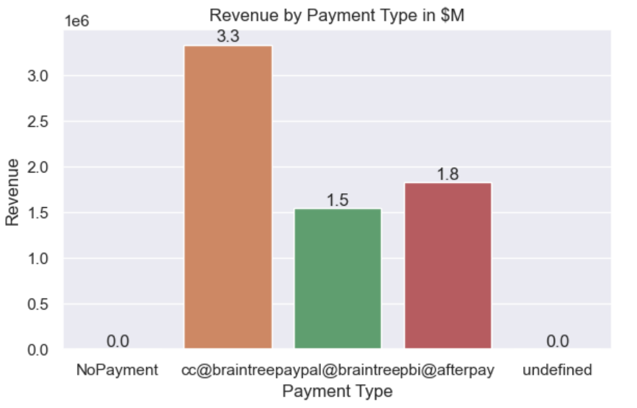
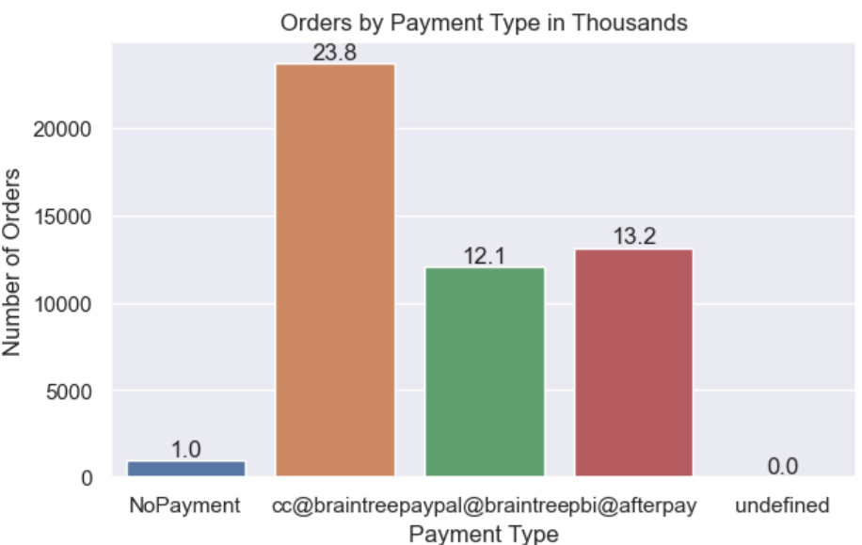
Orders and Revenue by Payment Type
Highest revenue and sales by payment type:
cc@braintree
pbi@afterpay
paypal@braintree
Amount paid using cc@braintree is 120% more than paypal@braintree and 100% more than pbi@afterpay
Number of orders using cc@braintree is 96% more than paypal@braintree and 80% more than pbi@afterpay
Strong customer base and usage with cc@braintree

Slide 10
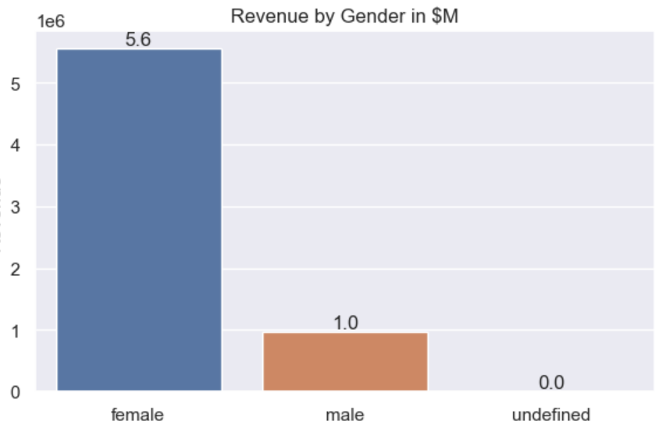
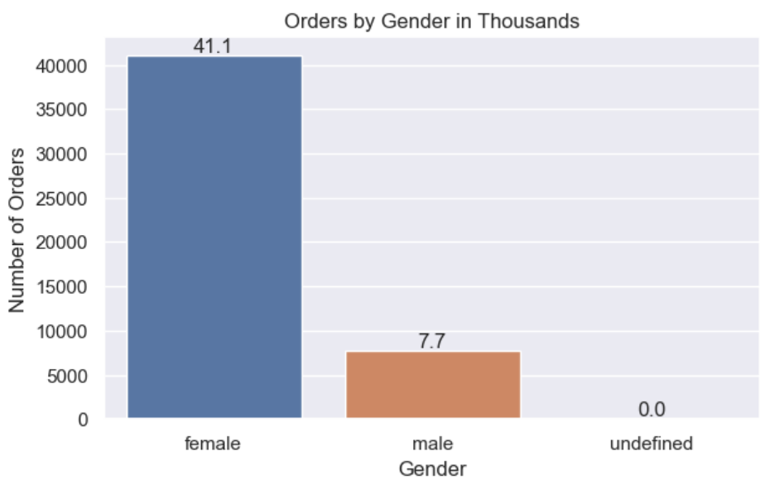
Orders and Revenue by Payment Type
‘User_Gender’ column is missing 1174 rows of data
Highest revenue and sales by Gender:
Female- 84%
Male - 16%
There is room to cater for the different needs of both genders

Slide 11
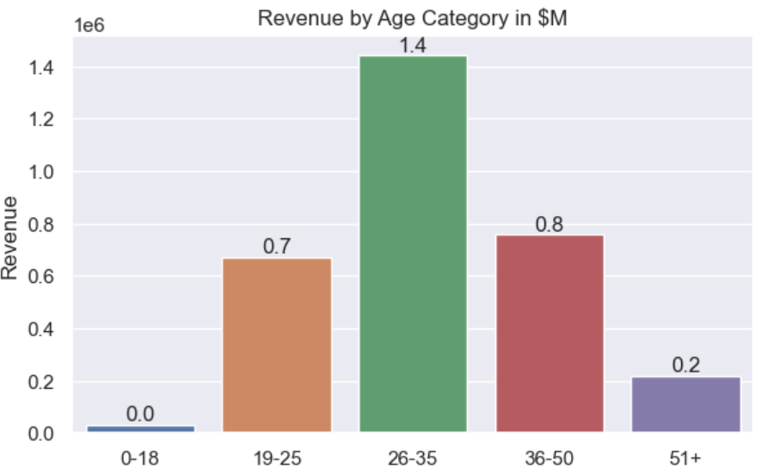
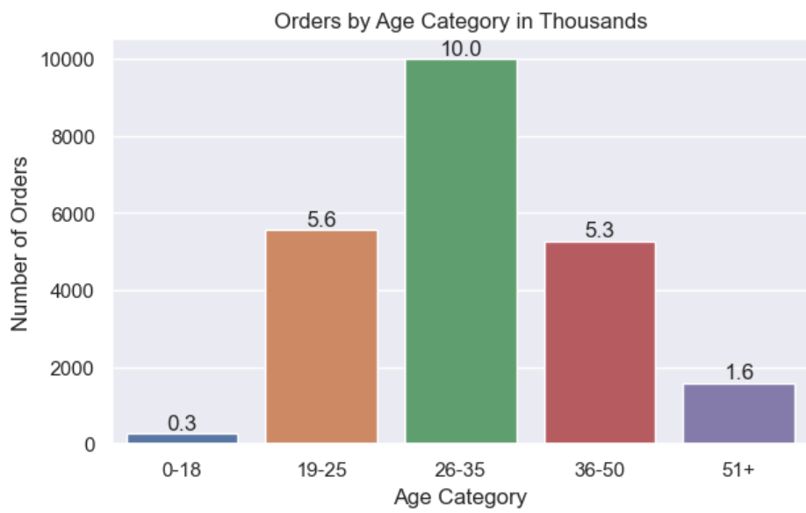
Orders and Revenue by Age Category
There are 27275 missing rows for user birthday, but this a big enough sample.
Highest Revenue:
26-35
Highest orders:
26-35
Product seems to target mainly young adults, middle-age and seniors

Slide 12
Basket view

Slide 13
1.97
$134.1
51%
49%
Avg Unique Quantity per Order
Avg Revenue per Order
Single Purchases
Multiple Purchases

Slide 14
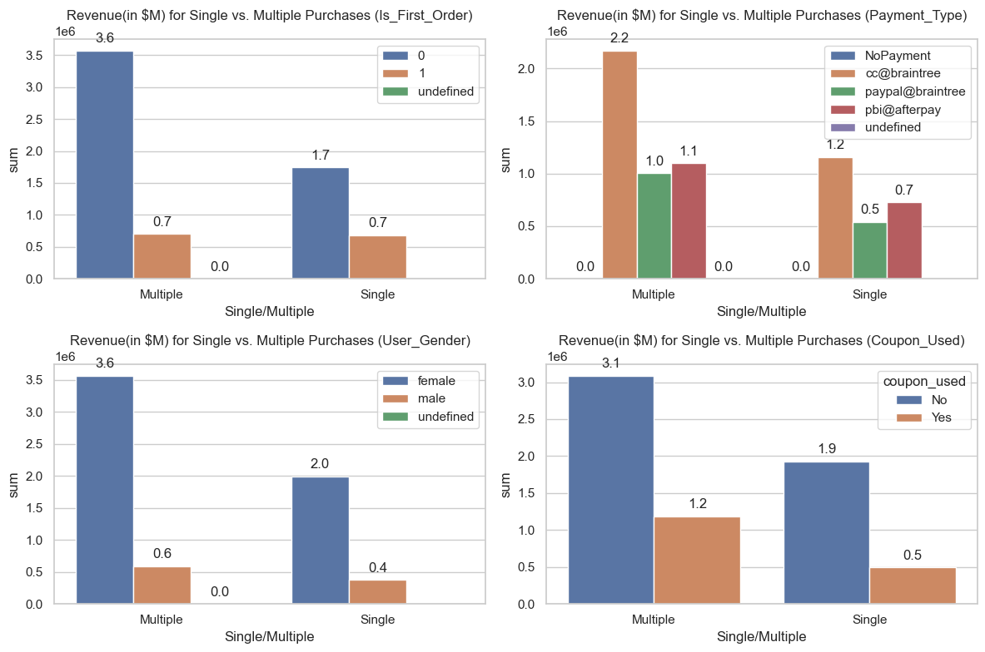
Single vs Multiple Purchases - Revenue by Attributes
First orders(1=first order):
Similar revenue for multiple and single purchases.
Revenue of multiple purchases is 117% more than single purchases for non-first orders
Payment Type:
Revenue from multiple purchases using cc@braintree is 83.3% higher compared to single purchases.
Revenue from multiple purchases using paypal@braintree is twice of single purchases.
Gender:
Revenue for multiple purchases for female users is 80% higher than Single.
Coupon:
Revenue for multiple purchases with coupons is 140% more than single purchases.

Slide 15
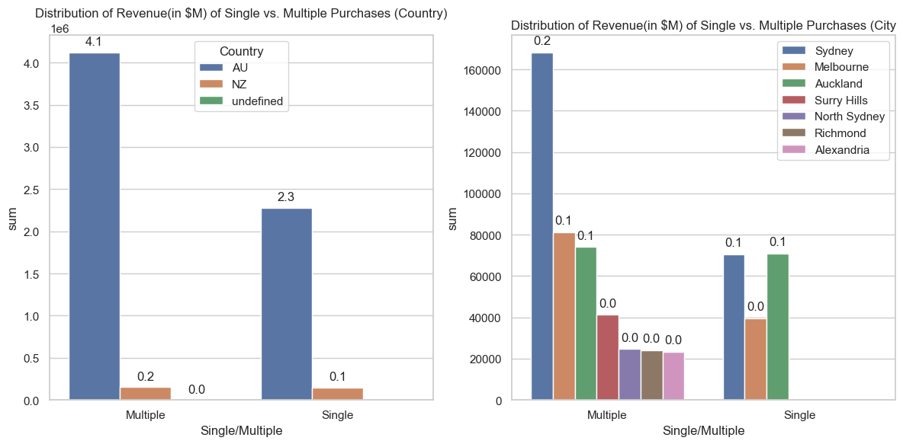
Single vs Multiple Purchases - Revenue by Geography
For City - Comparison based on top 10 cities by Revenue for Single and Multiple Purchase
Country:
94% of sales are from AU
In AU, 80% more multiple purchases than Single
City(Top 10 Revenue):
Single Purchases only come from 3 cities: Sydney, Auckland, Melbourne
Multiple purchases includes Surry hills, North Sydney, Alexandria and Richmond
Sydney, Melbourne, Auckland has the highest revenue for both multiple and single purchases

Slide 16
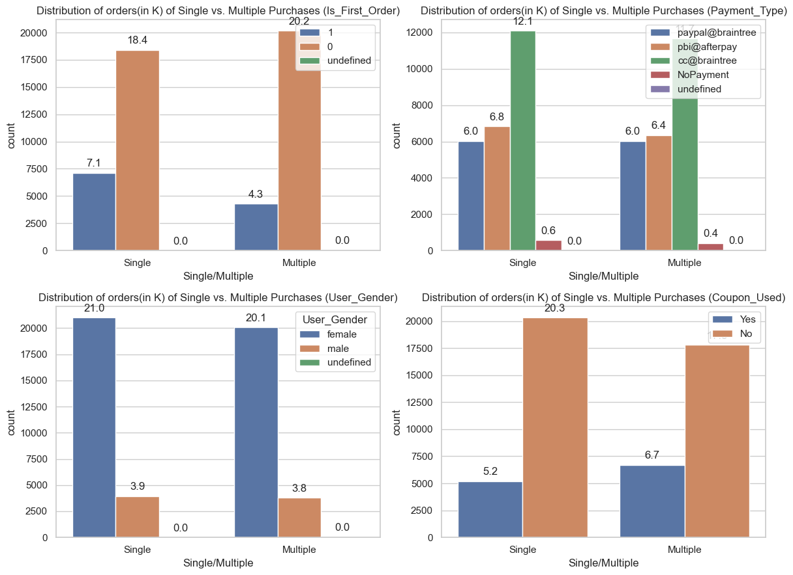
Single vs Multiple Purchases - Orders by Attributes
First orders:
Same proportion of multiple and single purchases for first orders
Proportion of multiple purchases is 104% than single purchases for non-first orders
Payment Type:
Proportion of Users with Multiple order purchases use cc@braintree 87.47% more than single Purchases
Gender:
Proportion of Female vs Male are similar
Coupon:
Higher proportion of users who use coupons to purchase multiple items compared to Single items

Slide 17
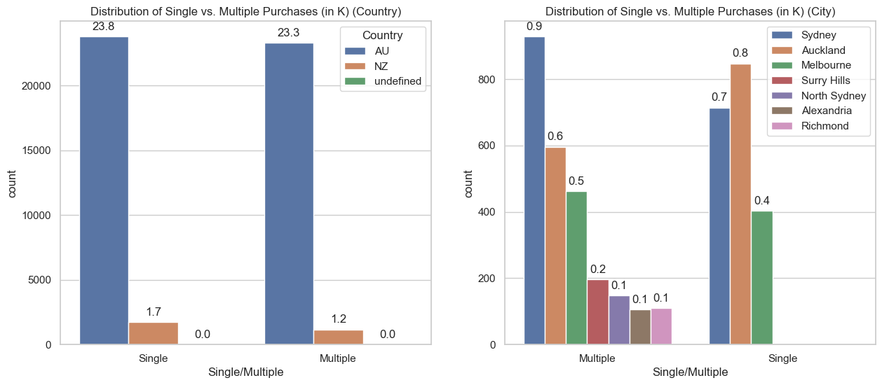
Single vs Multiple Purchases - Orders by Geography
For City - Comparison based on top 10 cities by Revenue for Single and Multiple Purchase
Country:
94% of sales are from AU
Proportions of single/multiple purchase similar for both countries.
City:
Single Purchases only come from 3 cities: Sydney, Auckland, Melbourne
Multiple purchases includes Surry hills, North Sydney, Alexandria and Richmond

Slide 18
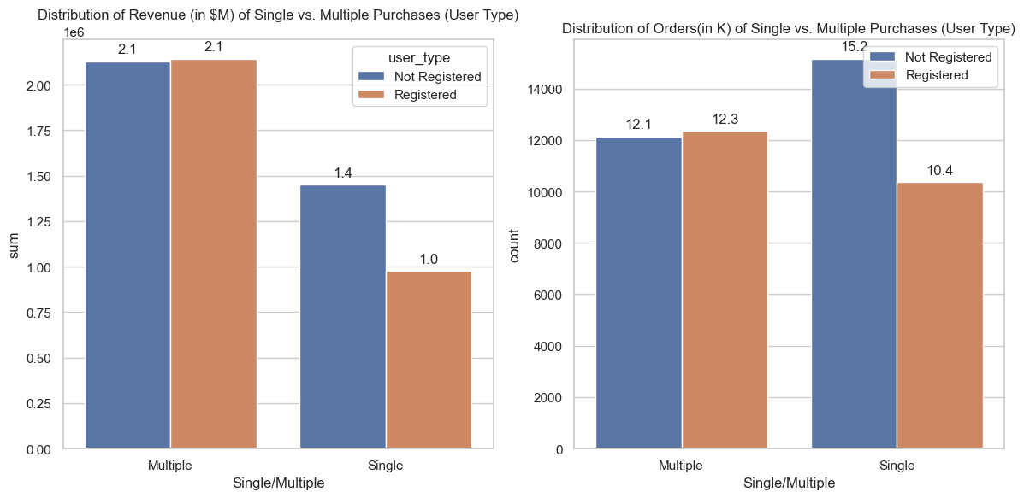
Single vs Multiple Purchases - Order and Revenue by User Type
User Type:
Revenue and sales for single purchases by non-registered users are 48% more than those by registered users.
Non Registered users, for single purchases, contribute significantly more than registered users
Potential to convert to registered user and enhance revenue
The user registration status does not seem to significantly impact the proportion of revenue and sales for multiple purchases.

Slide 19
Product Affinity

Slide 20
Top 10 Products Sold Together
Products combinations | Count
(NI126AA40TEL, NI126AA41TEK) | 8
(CA221AC27YSE, CA221AC29UPY) | 6
(ON866AA63CDC, ON866AA65CDA) | 5
(ON866AA63CDC, ON866AA64CDB) | 5
(NI126SA70ZTL, NI126SA78QUZ) | 5
(LY151AA05YNM, LY151AA23YMU) | 4
(MI202AA30ORL, MI202AA31ORK) | 4
(CA221AC27UQA, CA221AC29UPY) | 4
(AT049AA65FBY, AT049AA68FBV) | 4

Slide 21
Segmentation

Slide 22
Customer Segmentation based on Revenue
High-Value Customers: Customers in the top 20% of revenue.
Characteristics: High spenders, Multiple Purchases, strong brand loyalty.
Medium-Value Customers: Customers in the 20-80% range of revenue
Characteristics: Moderate spenders, multiple purchasers, Single Purchases.
Low-Value Customers: Customers in the bottom 20% of revenue.
Characteristics: single purchasers, lower spending.

Slide 23
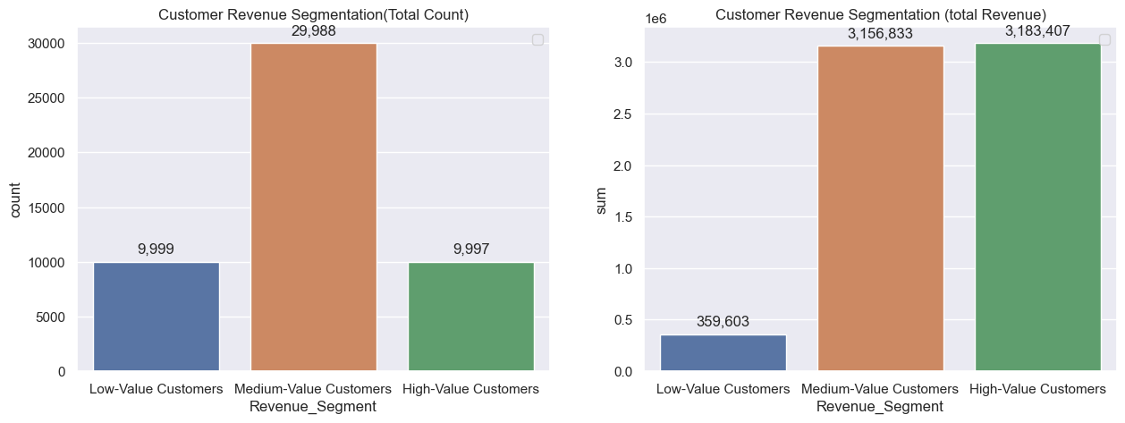
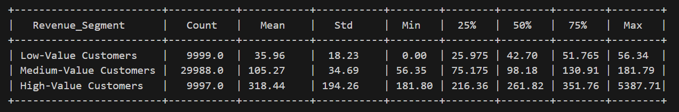
Customer Segmentation Overview

Slide 24
Segment Characteristics
High-Value Customers
Medium-Value Customers
Low-Value Customers
Single/Multiple
Payment Type
First order?
Top 3 cities
How many Unique Products
Registered/non registered
Single/Multiple
Payment Type
First order?
Top 3 cities
How many Unique Products
Registered/non registered
Single/Multiple
Payment Type
First order?
Top 3 cities
How many Unique Products
Registered/non registered

Slide 25
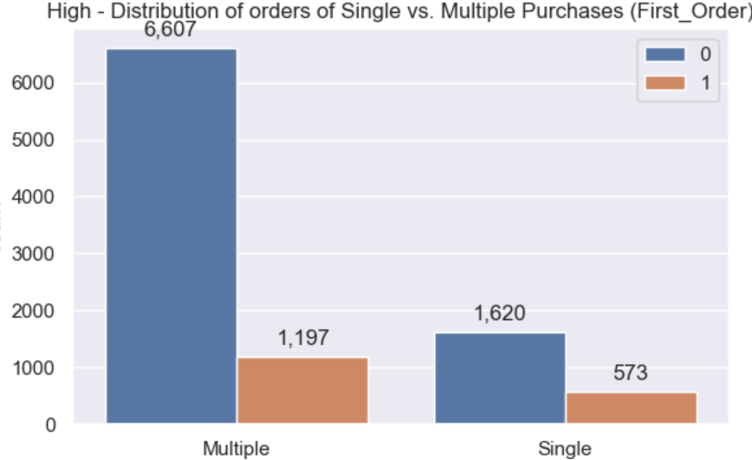
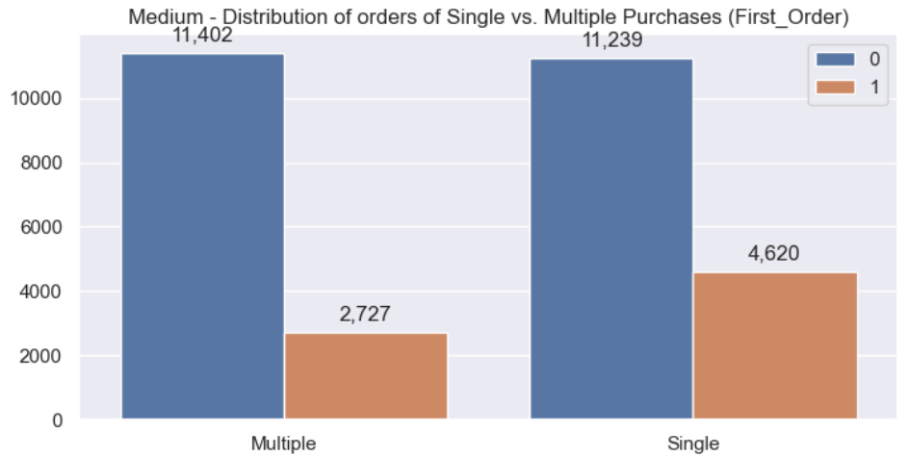
High Value vs Medium Value Orders - First order
High-Revenue Customers:
Average product purchased: 3.6
78% are multiple purchases
This suggests a higher level of engagement and interest in a variety of offerings.
84% of multiple purchases are not first orders
Highlighting a trend of repeat business.
Medium Revenue Customers
Average product purchased: 1.7
Proportion of Multiple and Single Purchases that are not first orders are similar:
The likelihood of making a first order is consistent across different types of transactions.
Single purchases have a 69% higher rate of being first orders compared to multiple purchases.

Slide 26
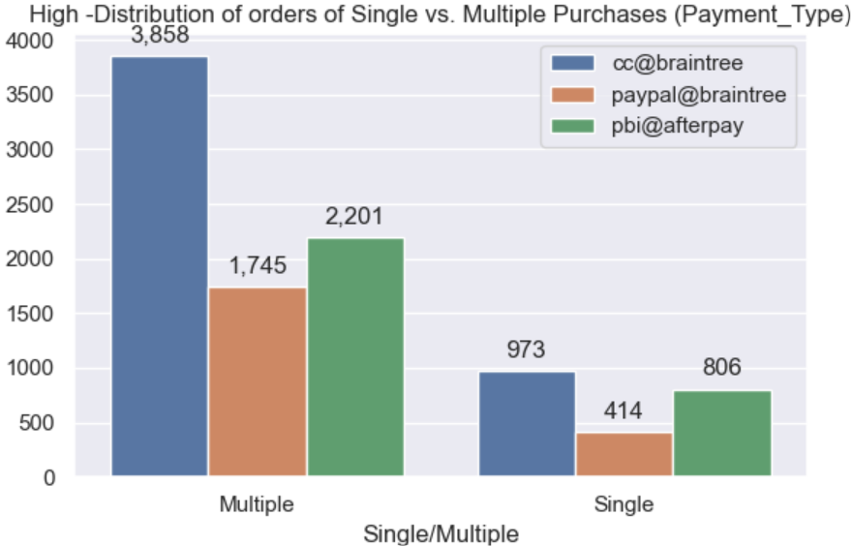
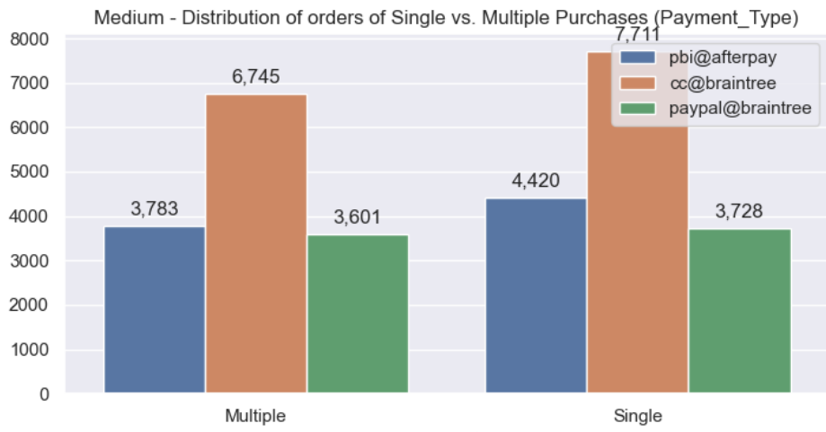
High Value vs Medium Value Orders - Payment Type
High-Revenue Customers:
49% of Multiple Purchases and 44% of Single Purchases used cc@braintree
Followed by pbi@afterpay and paypal@braintree
Medium Revenue Customers
47% of Multiple Purchases and 48% of Single Purchases used cc@braintree
Followed by pbi@afterpay and paypal@braintree
Conclusion
Common payment method: CC@braintree
There is consistency across customer segments
Strong Payment preference using the Braintree Payment gateway

Slide 27
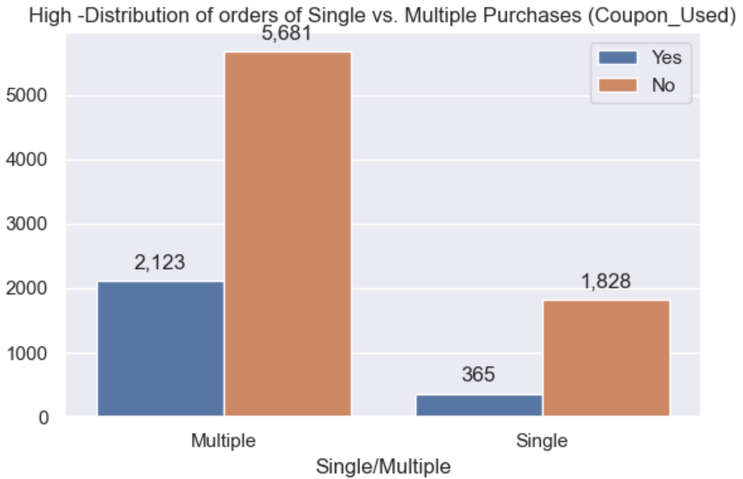
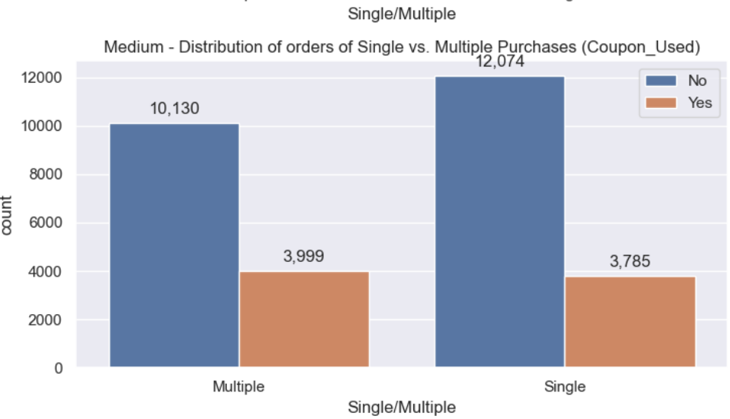
High Value vs Medium Value Orders - Coupon used
High Revenue
Multiple purchases have a 481% higher rate of using coupons compared to single purchases
implies that discounts or promotional offers may play a role in encouraging repeat business among this segment.
Medium Revenue
Proportion of coupons used for both multiple and single purchases are similar.
Difference in coupon usage patterns:
May need to tailor their coupon and discount strategies based on the spending behavior of different customer segments.

Slide 28
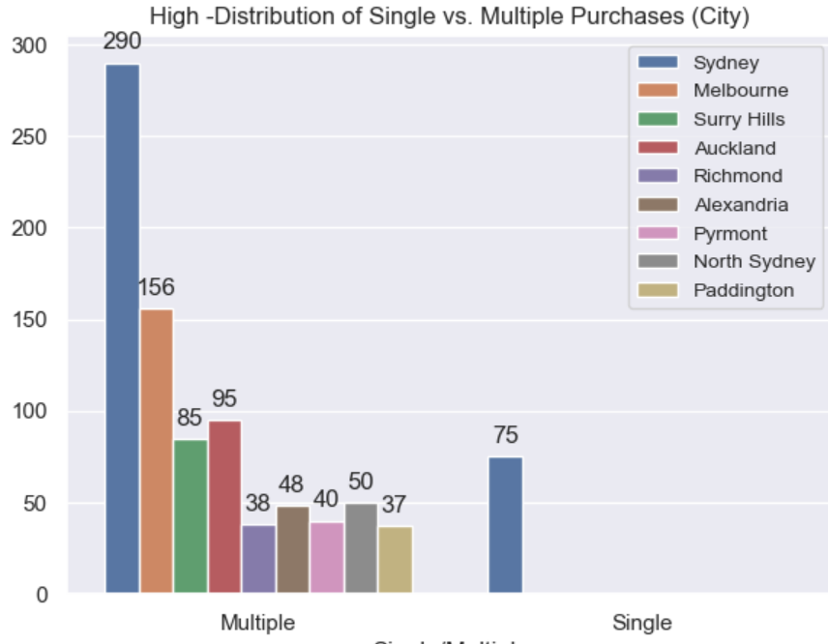
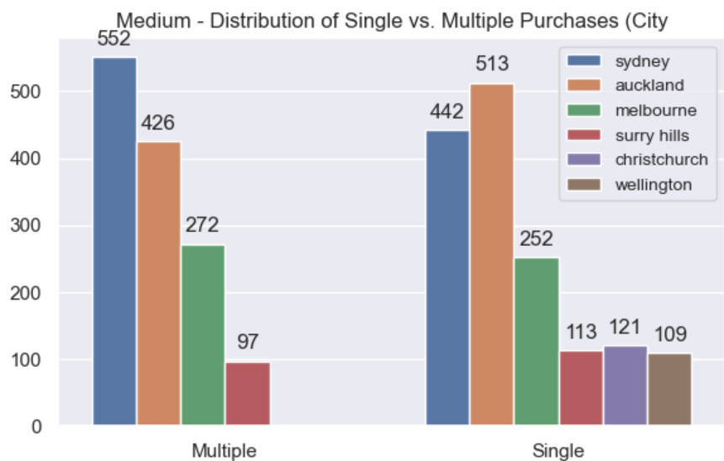
High Value vs Medium Value Order - City
Comparison based on top 10 cities by Revenue for Single and Multiple Purchase
High-Value
91% of all orders are multiple purchases
All top Cities orders are multiple purchases
Customer segment is spread across various regions.
Sydney has significant market value with 34% of Multiple and 100% of single purchases
Sydney dominate both multiple and single purchases
Medium Value
46% of orders are multiple purchases and 54% are single purchases - balanced
More cities with single purchases (6)compared to multiple purchases(4)
Customer segment is spread across various regions.

Slide 29
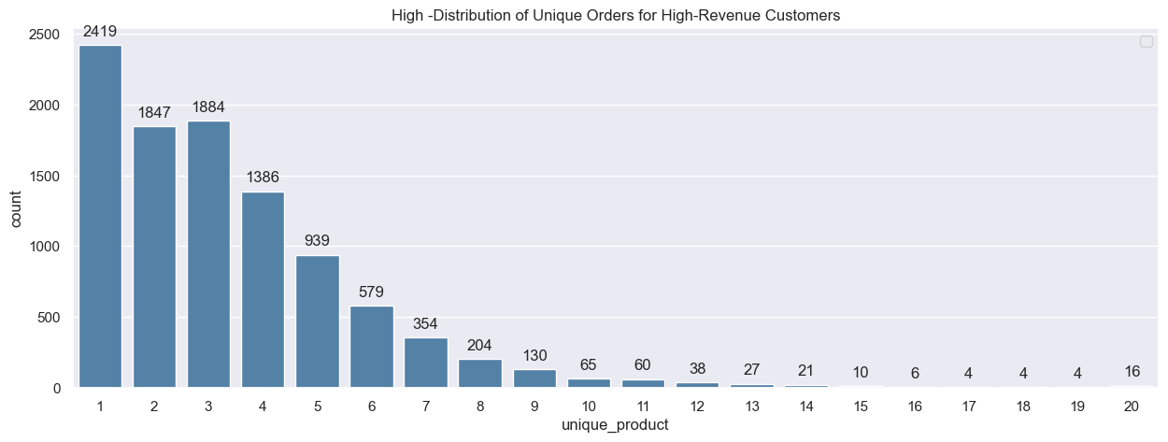
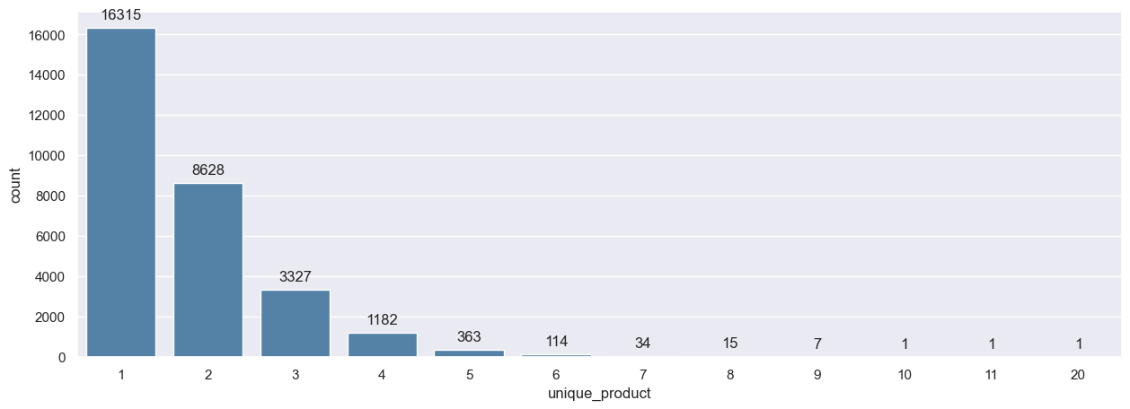
High Value vs Medium Value - Unique Orders
Unique Products | High Revenue Order % | Medium Revenue order %
1 | 24 | 52
2 | 18 | 31
3 | 19 | 11
4 | 14 | 4
5 | 10 | 1
6 | 6 | 0
7 | 4 | 0
8 | 2 | 0
9 | 1 | 0

Slide 30
Expanding Brand Reach

Slide 31
Focus
Time Dimension:
Promotions Focus: Consider targeting promotions on Wednesdays and during morning hours for optimal results.
Regional Analysis:
Multiple Orders Disparity: Explore why other cities have more multiple orders. Tailor marketing budgets, promotions, and product offerings based on regional revenue patterns.
Payment Type:
cc@braintree Promotion: Leverage the popularity of cc@braintree for targeted marketing, attracting new customers, and encouraging existing ones to make more purchases.
Coupon Use:
Segmented Coupon Strategies: Implement segmented coupon strategies, focusing on high-revenue customers making multiple purchases. Understand differing preferences within customer segments for optimized impact.
High Revenue Customers:
Diverse & Engaged Behavior: High-revenue customers exhibit diverse and engaged purchasing behavior.
Repeat Business: High percentage of multiple purchases indicates strong customer loyalty.
Medium Revenue:
Medium-revenue Customers:
New Business: Customers consistently make first-time purchases (new customers), contributing to business growth.

Slide 32
Actions
Time Dimension:
Promotions Focus: Schedule targeted promotions on Wednesdays and during morning hours,leveraging various channels for time-specific deals
A/B Testing to see if targeted advertising affect sales revenue. T-test to determine significance.
Regional Analysis:
Conduct surveys to understand regional preferences and customize marketing messages to align with region preference.
ANOVA test to determine if there are statistically significant difference in revenue across regions
Payment Type:
Feature promotions specifically for customers using cc@braintree, emphasizing convenience and security
Coupon Use:
Create exclusive coupon codes for high-revenue customers.
Implement personalized email campaigns targeting high-revenue customers with these exclusive offers.
Logistic regression to see likelihood of multiple purchase when using a coupon
High Revenue Customers:
Feature product bundles or exclusive items to encourage multiple purchases.
Engage high-revenue customers through loyalty programs or VIP memberships
Medium Revenue Customers:
New Business: Implement a "Welcome Discount" for first-time purchases to encourage initial engagements.

Slide 33
Thank you

